Slide 1

Therapeutic spaces in schools: design to benefit care-experienced children and the adults who work with them
30 March 2021
Dr Emma Dyer

Slide 2
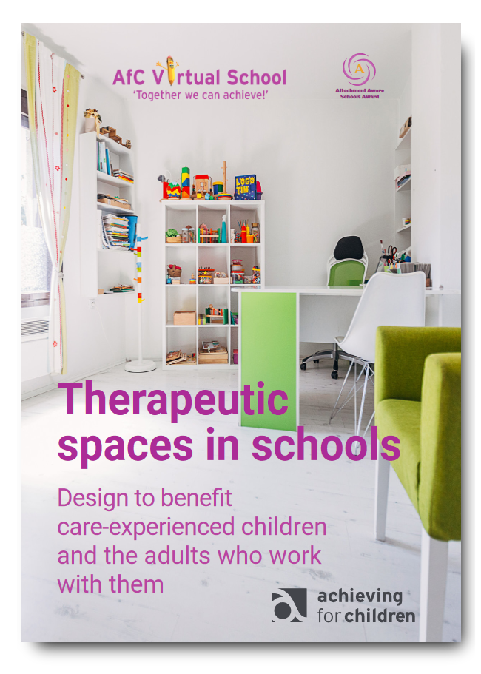



Slide 3
Research questions
What are the types and qualities of spaces currently being used in AfC schools to provide therapeutic interventions for children and young people?
What are staff perceptions of the spaces in which they provide therapeutic interventions?
What are the key factors of a therapeutic space that support the success of the interventions carried out in them?
How do changes/improvements to therapeutic spaces improve outcomes for those who use them (including children and young people & adults)?

Slide 4
Findings: A need for dedicated spaces
100 per cent of AfC schools surveyed employed at least one practitioner to support emotional wellbeing and mental health of children and young people.
This is a powerful investment in our children.
However, our survey also told us that only 25 per cent of those who responded in AfC schools had a designated location where this work could take place.

Slide 5
Practitioner voices:
small changes can make a big difference
“The main thing we’ve got from this is how much more open they are. Most children are far more open and open up more quickly. You don’t have to have a few sessions building up to it. It kind of saves time almost having a good space because they do feel comfortable and it is a nice space.”
“I think the children were more comfortable speaking to us quicker. Within five to ten minutes of their first session they’d be talking about their feelings. Before we had to go round the houses. It could sometimes take several sessions before they felt comfortable talking.”

Slide 6
Practitioner voices:
obstacles to overcome
“Understanding of privacy at times has been difficult with staff … they’re not actually realising how confidential our work is and they’re going up and speaking to the child. I don’t think they really realise what we do … and then … the children forget what they were going to say.”
“Sometimes people will come in and interrupt even if there is a sign on the door.”
“The constant interruptions when we are with a child is an issue also. I have tried putting signs up saying ‘Do not disturb’, I’m constantly telling people not to interrupt when I have a child with me but invariably they will still knock and say ‘sorry, but …”

Slide 7
Practitioner voices:
designation of the room
“I cannot stress enough the importance of a dedicated space to do my work in. As a full-time ELSA my day is spent constantly trying to find somewhere to do my sessions, not always knowing how a session will go. I also don’t always have all the correct equipment with me, i.e. puppets, worry teddies, therapeutic putty, strategy books. I take what I can and know I’ll need but sometimes a session doesn’t go the way I planned and then I have to quickly run to where my things are kept to get them. Also if a student is having a bad day and needs some time, they never know where I’m going to be.”
“Sometimes people need to use it for other things, meetings etc. We struggle to find a space when that happens”

Slide 8
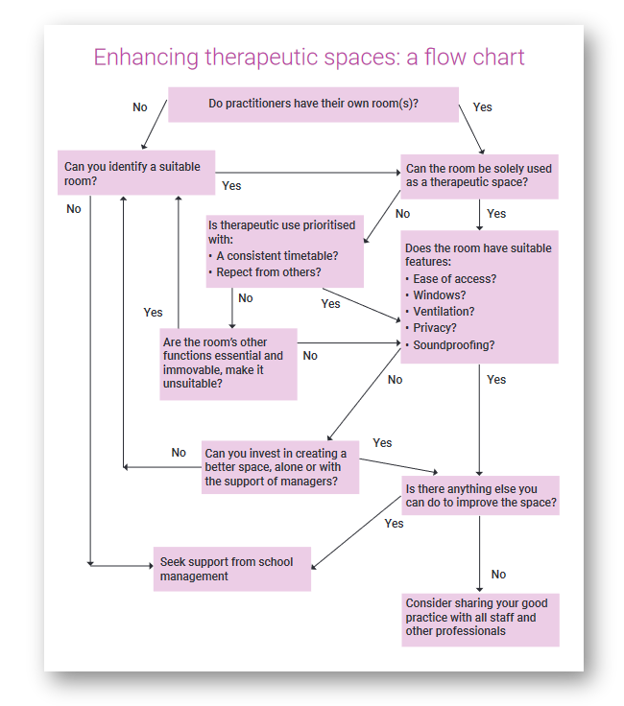
Design recommendations

Slide 9
Design recommendations
Think about the behavioural aspects of design as well as physical qualities of spaces (signage/status of therapeutic work).
Audit and evaluate the features and qualities of spaces in your own school.
Gather the views and experiences of practitioners in your school.
Involve children and young people in any design changes and improvements.
Focus on making incremental changes that can have a beneficial effect:
small changes can make a big difference.

Slide 10
Conclusions
Communicate the value of the work that takes place in these spaces and the mental health and wellbeing of everyone who uses them.
Ensure that practitioners are heard and that their work with children and young people is understood by the whole school community; involve them in designing these spaces.
Reflect on what is needed from the space: e.g. a protected, safe space where children and young people feel they belong and can express feelings to a trusted adult. Involve them in design.
Think imaginatively about the access, location and decoration of rooms: to convey a sense of belonging and safety e.g. acoustic/visual protection; comfort; a ‘different feel’ from the rest of the school?

Slide 11
Why does this matter in the context of AfC Virtual School?

Slide 12
Next steps
Attachment Aware Schools programme: five schools are dedicating their AAS project to therapeutic spaces
Involving children and young people in the next stage of research
Promoting work across AfC and beyond.

