Slide 1

Therapeutic spaces in schools: design for attachment aware schools
Dr Emma Dyer & Dr Sara Freitag

Slide 2


What are the (physical) qualities and attributes of a school that make it feel like a school?

Slide 3
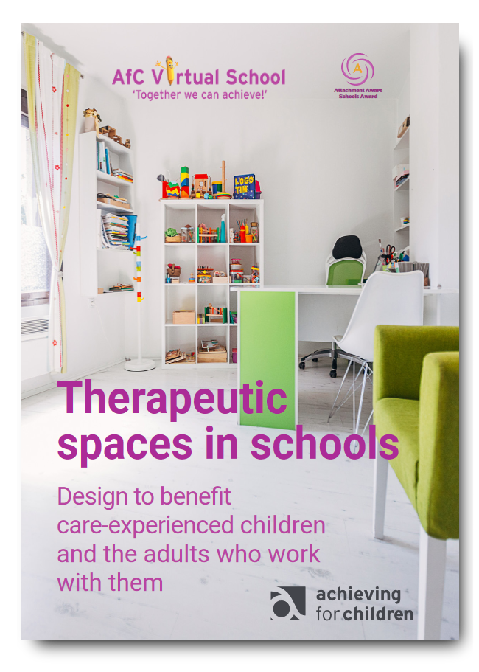

Slide 4
Small changes can make a big difference
“I think the children were more comfortable speaking to us quicker. Within five to ten minutes of their first session they’d be talking about their feelings. Before we had to go round the houses. It could sometimes take several sessions before they felt comfortable talking.”
ELSA, Primary school.

Slide 5
FIVE TOP TIPS
FOR DESIGNING A THERAPEUTIC
SPACE
IN YOUR SCHOOL

Slide 6
ONE:
Go back to basics

Slide 7
TWO:
Take a seat (or two)

Slide 8
THREE:
How does it sound?

Slide 9
FOUR:
A protected space

Slide 10
FIVE:
Design with …

Slide 11
Choose your own top three things or qualities that you value in a therapeutic space

Slide 12
Therapeutic spaces in schools: design for attachment aware schools
Emma.Dyer@achievingforchildren.org.uk

